Slide 1

PHS650: Rigor and Reproducibility in the Social, Behavioral, and Population Health Sciences
Dr. Katherine Schaumberg
Wk 4 – Lecture 1

Slide 2
Metadata Best Practices
LOTS of Data Types, each with best practices: https://www.axiomdatascience.com/best-practices/MetadataBestPractices.html

Slide 3
Codebooking/ Data dictionaries
Multi-item Scoring: exact information on how and why data was combined
Keep a data dictionary/codebook repository
Keep both raw and cleaned versions of data

Slide 4
Elements of a Data Dictionary
Study Metadata
Brief Project Description/Introduction to the parent project (similar to pre-registration)
Description of study procedures
Data dictionary for all key variables with easy-to-understand descriptions of the data
Link(s) to scoring code
Ideal: complete in tandem with data collection or requisition for entire project

Slide 5
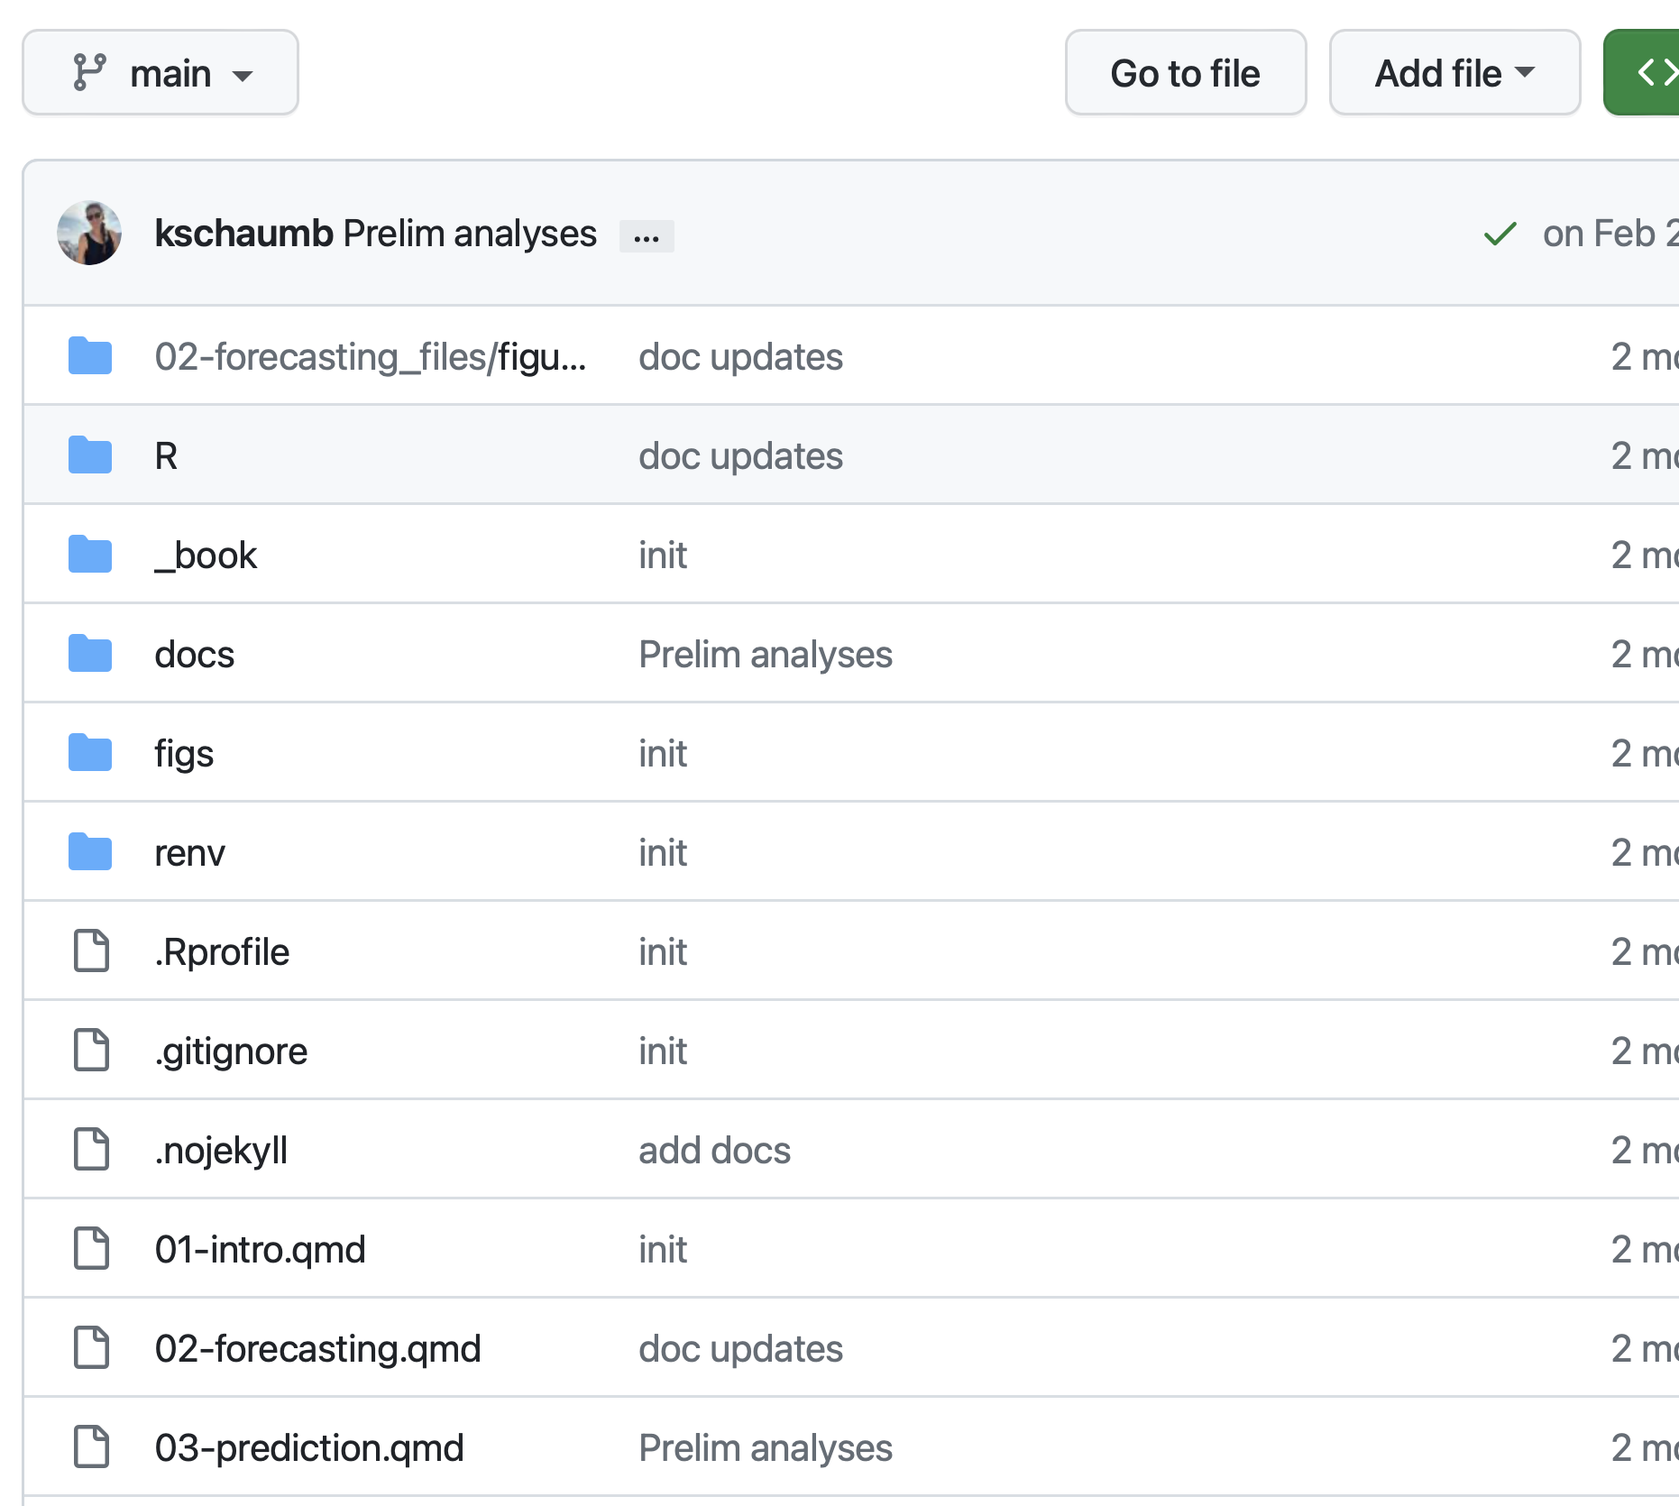
Repo
.qmd, .gitignore, other files that need to be in repo head
Scripts
Data
Figs
Envs
Rendered Docs

Slide 6
Data Cleaning
Data Cleaning Repo
Raw Data
Scoring Scripts
Cleaned Data

Slide 7
Data Cleaning
Data Cleaning Repo
Raw Data
Scoring Scripts
Cleaned Data
Codebook (Metadata) Repo
.qmd measures metadata
.qmd project metadata
.qmd descriptives
Cleaned Data
Rendered Codebook!

Slide 8
Data Cleaning
Data Analysis
Data Cleaning Repo
Individual Project Repos
Raw Data
Scoring Scripts
Cleaned Data
Cleaned Data
Analysis Scripts
.qmd files
Codebook (Metadata) Repo
Rendered Manuscript!
.qmd measures metadata
.qmd project metadata
.qmd descriptives
Cleaned Data
Rendered Codebook!

Slide 9
Long, Wide, or Both?
If you have a study with multiple timepoints, consider whether you want to keep the master dataset in long-form, wide-form, or both

